Slide 1
DEPARTMENT OF MECHANICAL ENGINEERING SUB CODE & NAME 18MES103L-BASIC CIVIL & MECHANICAL ENGINEERING WORKSHOP
EXPERIMENT 1
RECTANGULAR SHAPED TRY MAKING USING GI SHEET

Slide 2
INTRODUCTION
Galvanizing is a process of coating iron or steel with zinc in order to provide greater protection against corrosion for the iron or steel base.
The process of galvanizing sheet iron was developed simultaneously in France and England in 1837.
Both of these methods employed a "hot dipping" process to coat sheet iron with zinc. Like tinplate, early galvanized metals were hand dipped.
Today almost all galvanized iron and steel is electroplated.
Galvanizing protects the underlying iron or steel in the following main ways:
The zinc coating, when intact, prevents corrosive substances from reaching the underlying steel or iron.
The zinc protects iron by corroding first. For better results, application of chromates over zinc is also seen as an industrial trend.
In the event the underlying metal becomes exposed, protection can continue as long as there is zinc close enough to be electrically coupled. After all of the zinc in the immediate area is consumed, localized corrosion of the base metal can occur.

Slide 3
The following are the most common methods for applying protective coatings of zinc to iron and steel:
Hot-dip Galvanizing:
The immersion of iron or steel in molten zinc, after the surface of the base metal has been properly cleaned
This process gives a relatively thick coating of zinc that freezes into a crystalline surface pattern known as spangles.
During the process, a multiple layered structure of iron- or steel-zinc alloys is formed between the inner surface of the zinc coating and the iron or steel. These middle layers tend to be hard and brittle and may peel or flake if the iron or steel element is bent.
Electro galvanizing:
The immersion of iron or steel in an electrolyte, a solution of zinc sulfate or cyanide. Electrolytic action deposits a coating of pure zinc on the surface of the iron or steel.
Sherardizing:
The placing of a thoroughly cleaned iron or steel element in an air-free enclosure where it is surrounded by metallic zinc dust. The architectural element is then heated and a thin, zinc alloy coating is produced.

Slide 4
REQUIRED TOOLS FOR WORKSHOP
Cutting Tools
Grabbing and Clamping Tools
Measuring Tools
Writing Tools
Hammers and Mallets
Steel Ruler
Try Square
Scratch Awl
Aviation Shears
Foot Shear (optional)
Sheet Metal Brake
Anvil/Solid Surface
Spot Welder (Alternative: Power Drill and Pop Rivets)
Tape Measure

Slide 5
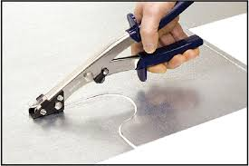
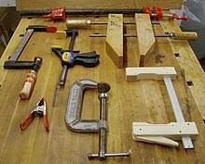
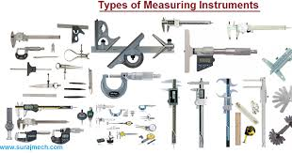
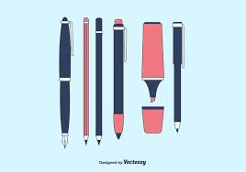
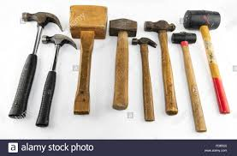
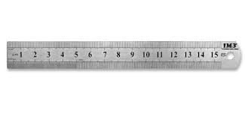
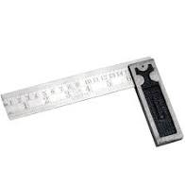
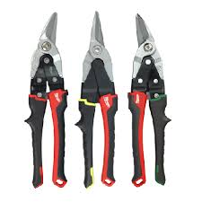
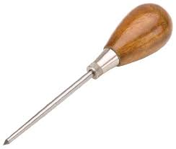
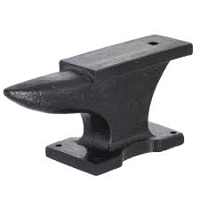
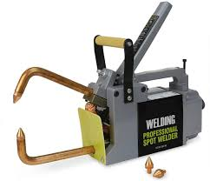
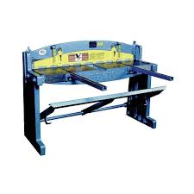
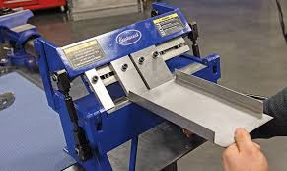
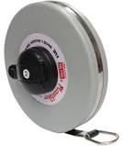
Tools Images

Slide 6
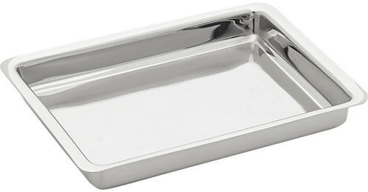
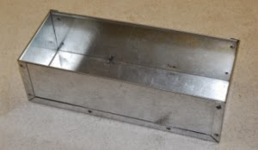
AIM
To make a Rectangular Tray of given size from a sheet metal piece.
APPLICATION
Cabinets of stabilizer, computer, UPS etc
SUPPLIED MATERIAL SPECIFICATION
Galvanized Iron sheet of dimensions 200mm x 150mm, Thickness 26 gauge
TOOLS REQUIRED
Steel RuIe
Anvil or Bench plate
Scriber
square Mallet
Straight snip
Try Square

Slide 7
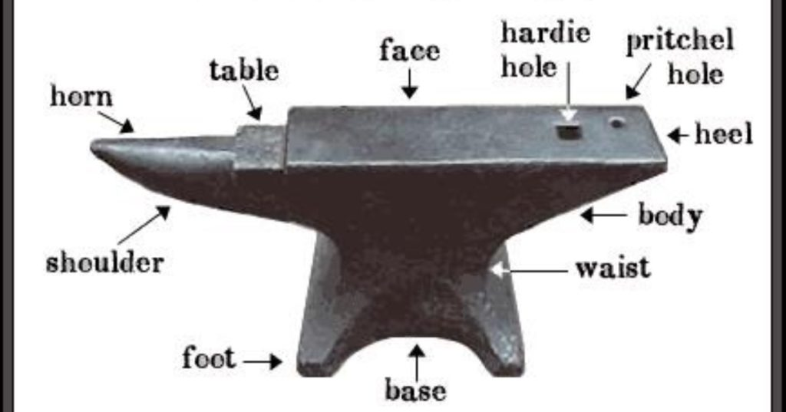
Anvil or Bench plate
An anvil is a metalworking tool consisting of a large block of metal (usually forged or cast steel), with a flattened top surface, upon which another object is worked

Slide 8
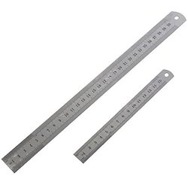
Steel RuIe
The rule is a strip of metal graduated in inches and fractions of an inch to give actual measurements.
When tolerances of fractional dimensions are required, the steel rule is used.

Slide 9
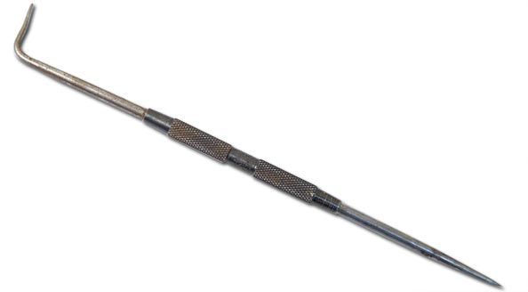
Scriber
A scriber is a hand tool used in metal work to mark lines on workpieces, prior to machining.
The process of using a scriber is called scribing and is just part of the process of marking out.
It is used instead of pencils or ink lines, because the latter are hard to see, easily erased, and imprecise due to their wide mark; scribe lines are thin and semi-permanent.

Slide 10
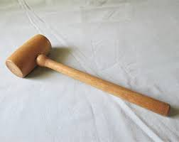
Wooden mallets
Wooden mallets are usually used in carpentry to knock wooden pieces together, or to drive dowels or chisels.
A wooden mallet will not deform the striking end of a metal tool, as most metal hammers would.
It is also used to reduce the force driving the cutting edge of a chisel, giving better control.
Hardwood mallets are also used to knock in cricket bats.

Slide 11
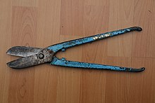
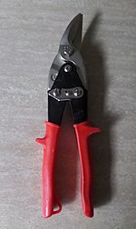
Straight snips
Straight snips are used for cutting a straight line and for curves having a large radius. Bent snips are used in cutting small curves.

Slide 12
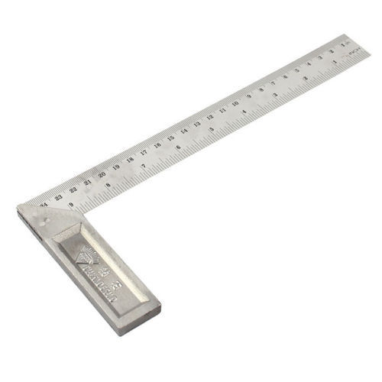
Try Square
A try- square is a woodworking tool used for marking and measuring a square piece of wood.
The square refers to the tool's primary use of measuring the accuracy of a right angle (90 degree angle); to try a surface is to check its straightness or correspondence to an adjoining surface.

Slide 13
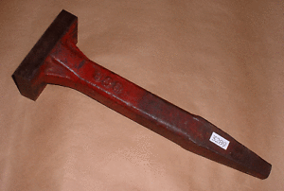
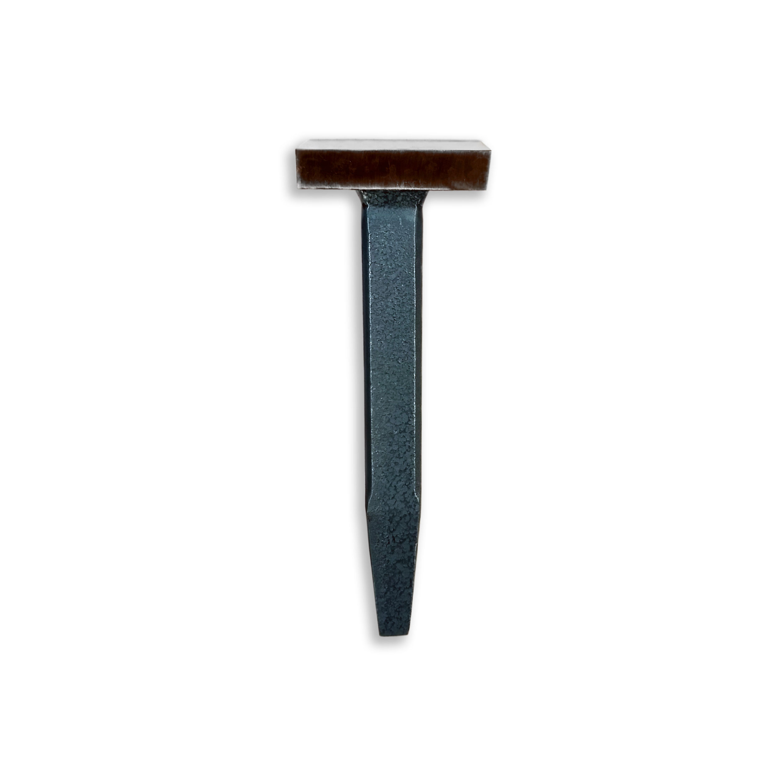
Square Stake
A square stake or stake anvil with a straight or tapering cylindrical arm and a spherical ended arm. Used for shaping, raising and planishing.

Slide 14
SEQUENCE OF OPERATIONS
I. Checking
II. Layout Marking
III. Shearing
IV. Folding
V. Locking and Seaming

Slide 15
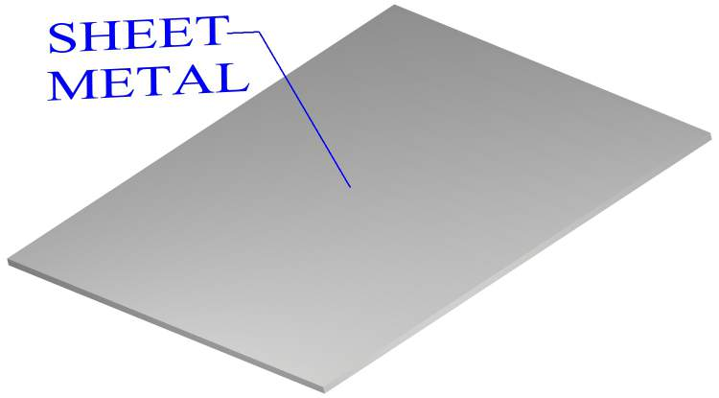
PROCEDURE
I. Checking
1. Check whether the given sheet is having its dimension as 200mm x 150mm. If the dimension is excess trim off using hand shear.
2. Keep one corner of the sheet between body and tongue of Steel Square and check whether the sides exactly coincide with Steel Square.
3. Keep this corner as reference corner and these two sides as reference sides. This corner should be kept at left hand side bottom position.

Slide 16
PROCEDURE
II. Layout Marking
1. Using steel rule and scriber draw horizontal lines at a distance of 10mm, 35mm, 165mm, 190mm and 200mm from reference vertical edge.
2. Similarly with respect to bottom edge draw vertical lines at a distance of 5mm, 30mm, 120mm, 145 mm and 150mm.

Slide 17
PROCEDURE
III. Shearing
To remove portion A cut along the direction shown by arrows.
2. To remove portion B cut along the direction shown. Use hand gloves to remove the cut portion.
IV. Folding
1. Keep the pattern over square stake such that the inner line of hem portion I exactly coincides with the edge of stake.
2. Fold this portion 90° downwards with the help of mallet
3. Remove the sheet, make further 90° fold over the portion I so that it form a hem along the edge. Similarly fold the portion J also.
4. Place the sheet over the stake such that the line 1-2 coincides with the stake edge
5. Bend the portion C, 90° downwards using mallet 6. Similarly bend portions D, E and F in the same order.

Slide 18
PROCEDURE
V. Locking and Seaming
1. The incomplete tray is having four corners. Keep one comer in align with the comer of stake. Using mallet fold the projection (Triangular in shape) 90° towards the tray. Repeat this step for all other projections.
2. Fold the remaining portions G and H 180° outwards using stake and mallet to lock the folds.
3. Check for the dimensions.
RESULT
Thus the required Rectangular tray is made out of the given sheet metal piece.

